Slide 1
telescience WG
Fang Pang Lin
Shinji Shimojo
Pragma 22

Slide 2
Our Goal
GLEON goes to PRAGMA cloud integrated with sensor networks
Realtime sensing and simulation, analysis and visualization
Science continuity Plan and scalability
Cloud+sensor network+visualization
Open sensor infrastructure
Sensor-ROCKS
Young GLEON talks with Young PRAGMA

Slide 3
Talks
Sameer Tilak
Sungyoung Han, “Study and Implementation of Video Transmission Using Overlay Network”
Fang-Pang Lin
Karpjoo Jeong, “Urban Monitoring”
Possibility of Future Project, “Disaster management, etc”

Slide 4
Structure
Day 1
information exchange
Day2
Joint WG with Geo and talk about structure
Discussion on overlay network with Resource WG.

Slide 5
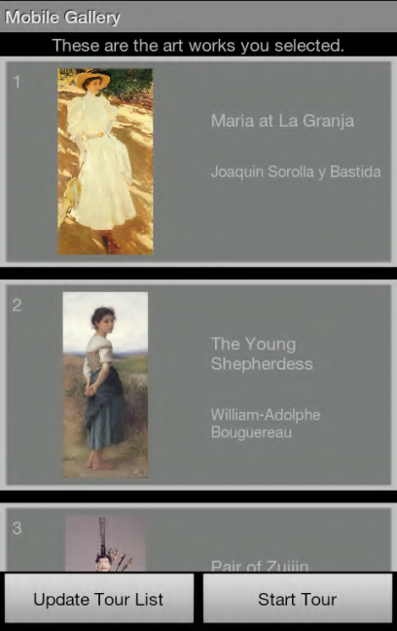
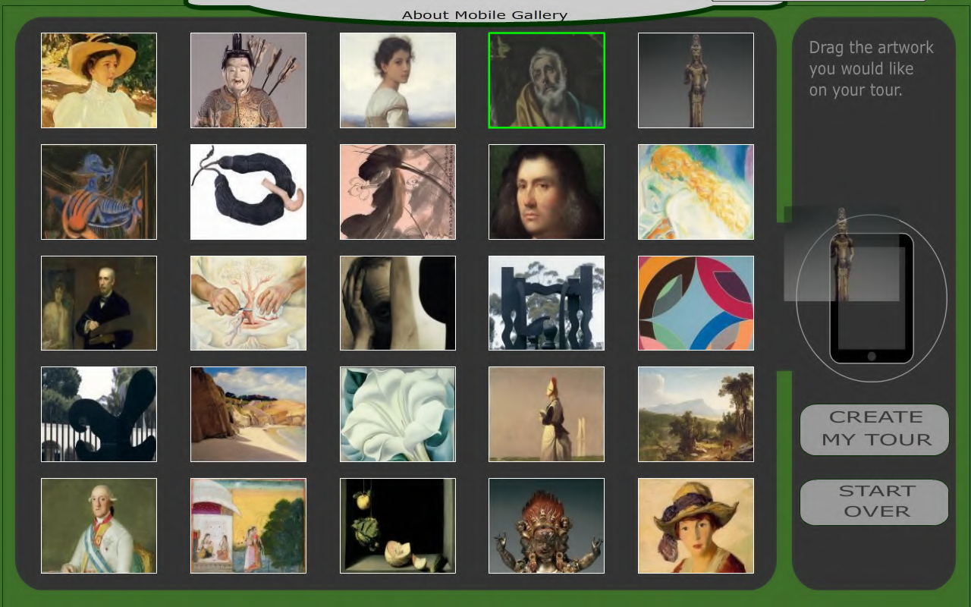
Mobile Gallary
PRIME project (Michael and Scott) with NICT, ISID, SDMA, UCSD
Touch table and Android
Location based service

Slide 6
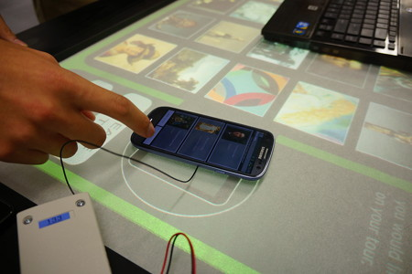
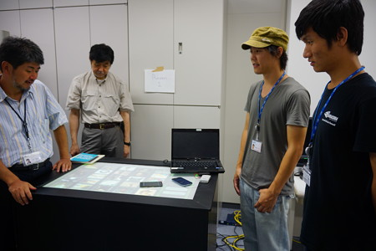

Slide 7
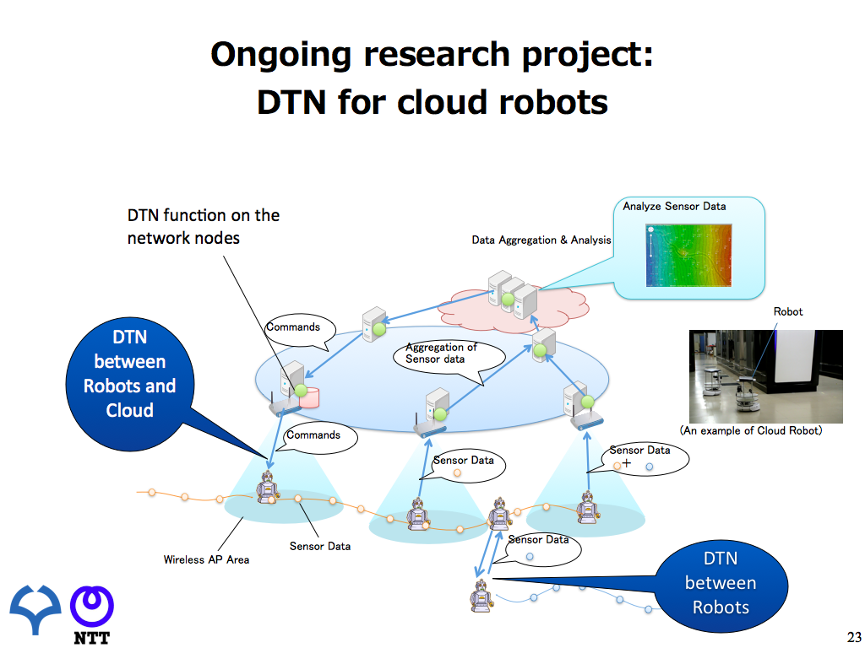

Slide 8
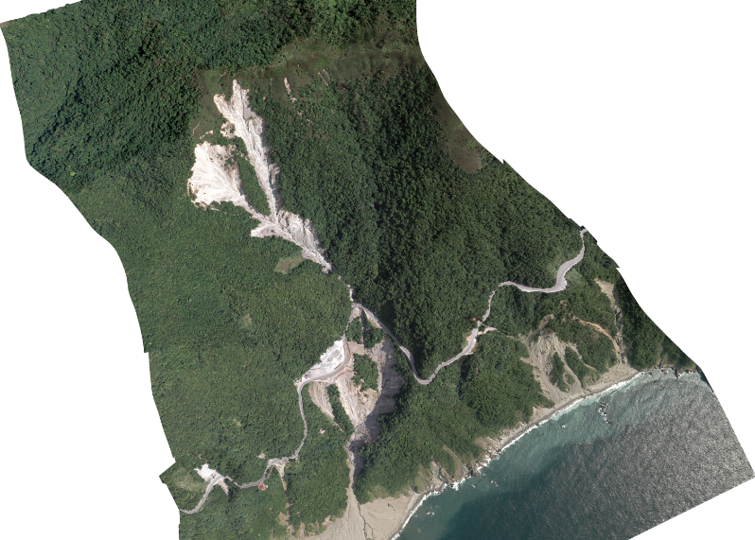
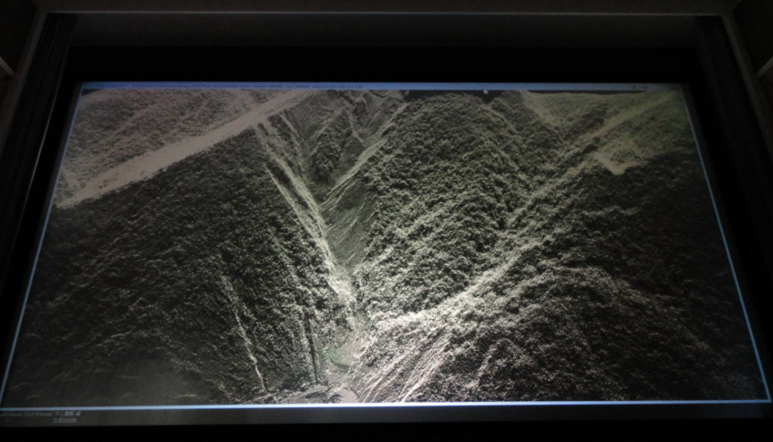
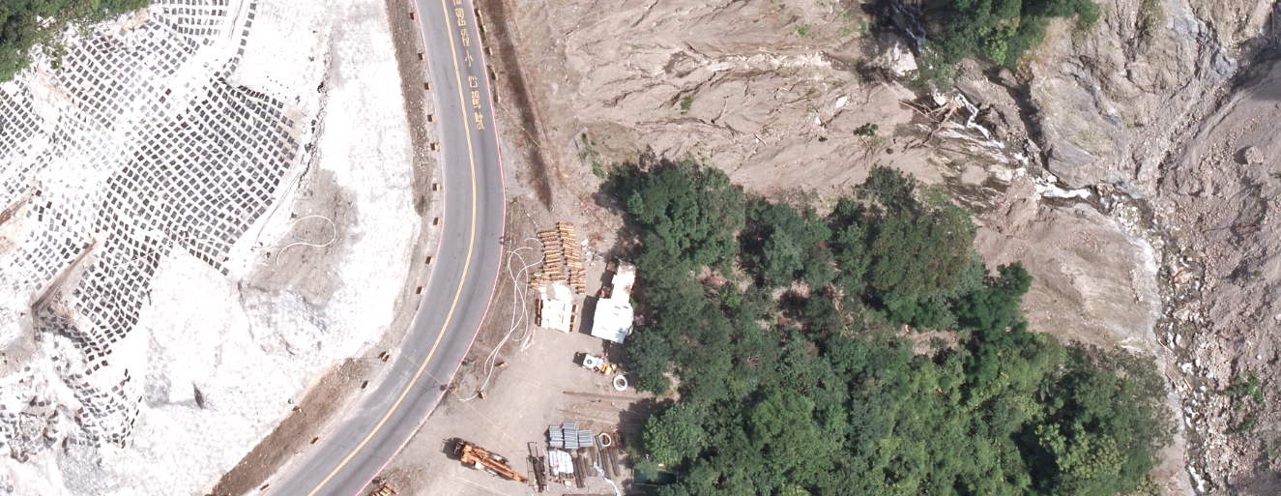
Large Data Visualization: 4K Projection: Large LiDar Point Cloud
Source: Strong Engineering Consulting Co, Ltd., Taiwan

Slide 9
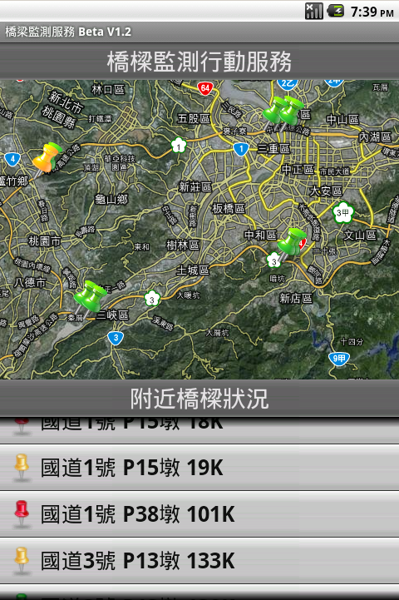
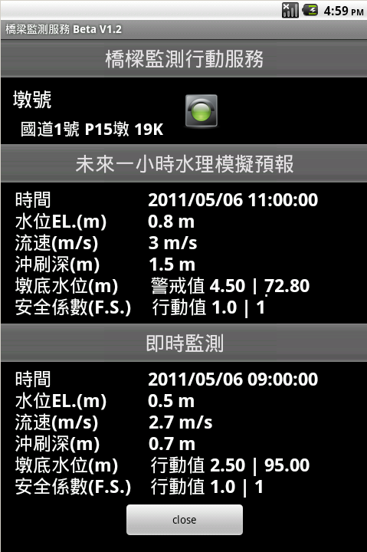
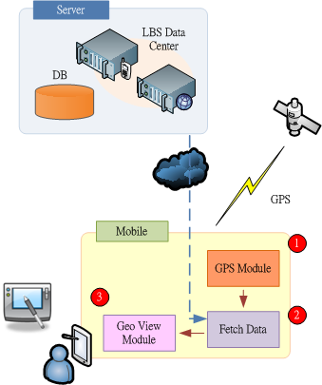
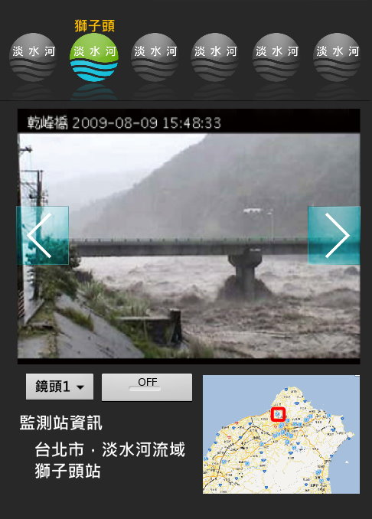
Move Clients to Mobile Device w/ sensors
Media Service
Media Server
Media Server
Media Server
Media Server
Source: Jyh-Horng Wu & Lu-Chi Chen, NCHC

Slide 10
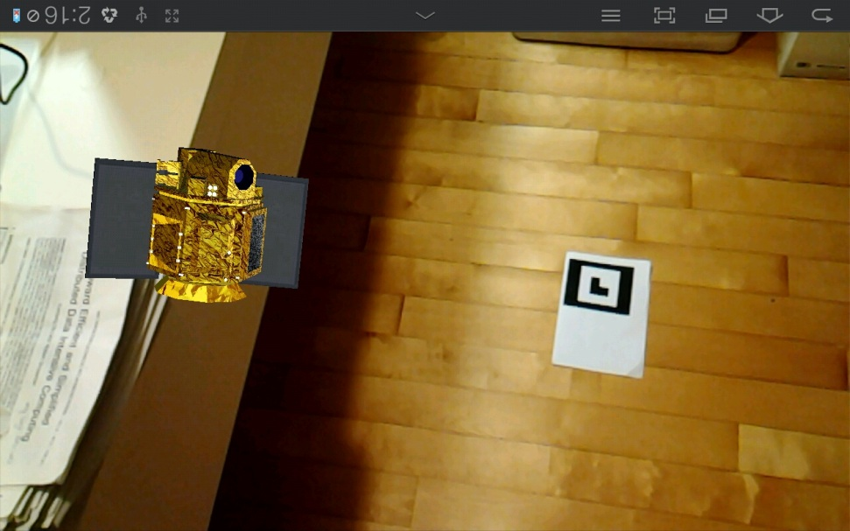
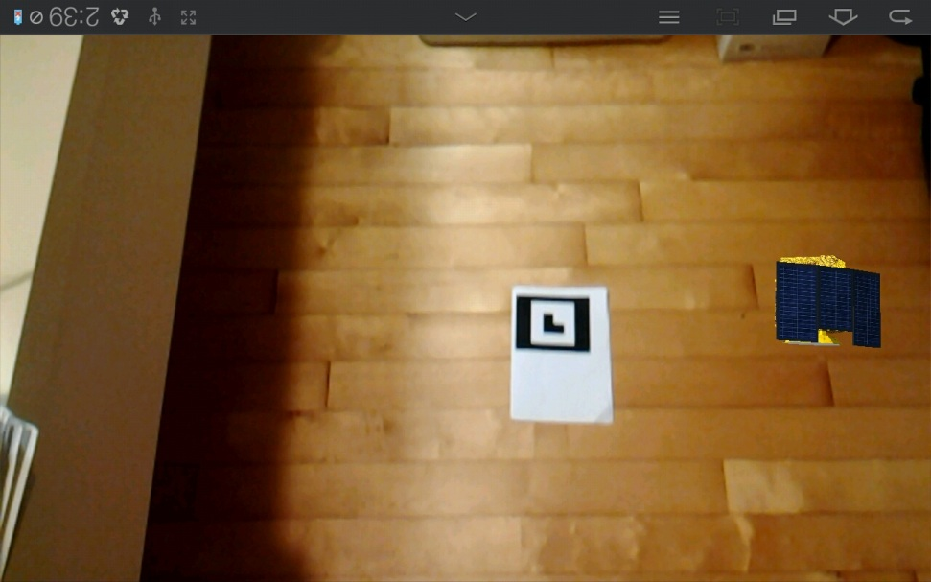
Move Clients to Mobile Device w/ sensors
Experience from 2011 PRIME collaboration.
Expected to extend to field study for environmental research.
Source: Lu-Chi Chen, NCHC

Slide 11
Challenge
Can we use Pragma Cloud?
Requirement?: security?, performance? Sustainability?, Reliability?
We will be joining with GeoScience WG
Funding?
CPS (Cyber Physical System) Project started in Japan.
Data infrastructure Meeting: 4-6, December@Taichung
Theme: "Bridging Big Data Infrastructures: Expeditions in the Network Science Landscape"

Slide 12
Discussion
We have a common element with GeoScience, Telescience, biodiversity
Sensor, Data, Cloud, Network
We would like to share data, simulation and analysis like GLEON/CLEON.

